Slide 1
Team 5 Conceptual Design
Dillon Williams
Nidhay Patel
Ryan Reed
Michel Turpeau
Austin Sigg

Slide 2
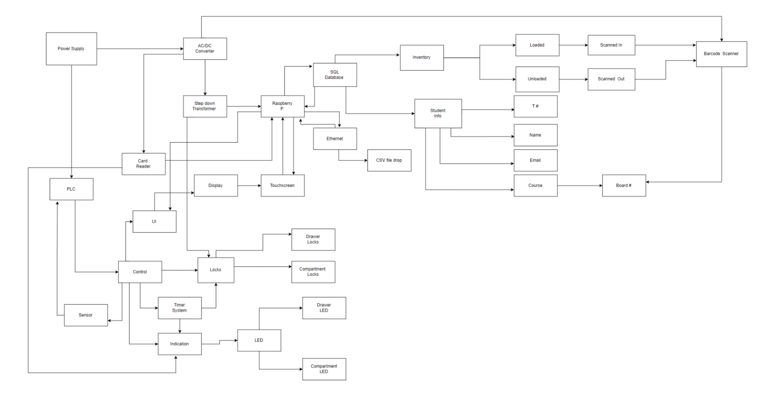

Slide 3
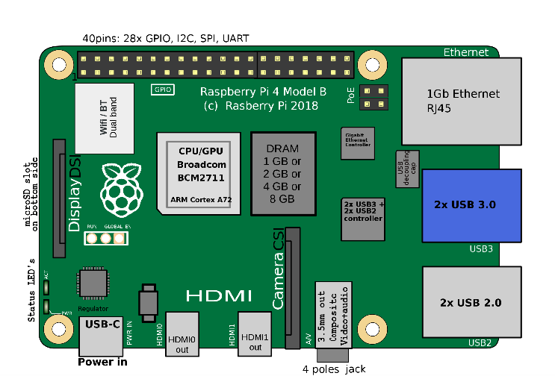
Microcontroller
Raspberry Pi Model 4 B
Card Reader
Input: Signal/Message/Information from Eagle Card
Output: Create Data and signal Microcontroller Unit
UI
Raspberry Pi LCD touchscreen
Input: Information from Student
Output: Raspberry Pi signaling PLC

Slide 4
Pi connections
Raspberry Pi
SQL Database
Touchscreen
Eagle Card Reader
Ethernet

Slide 5
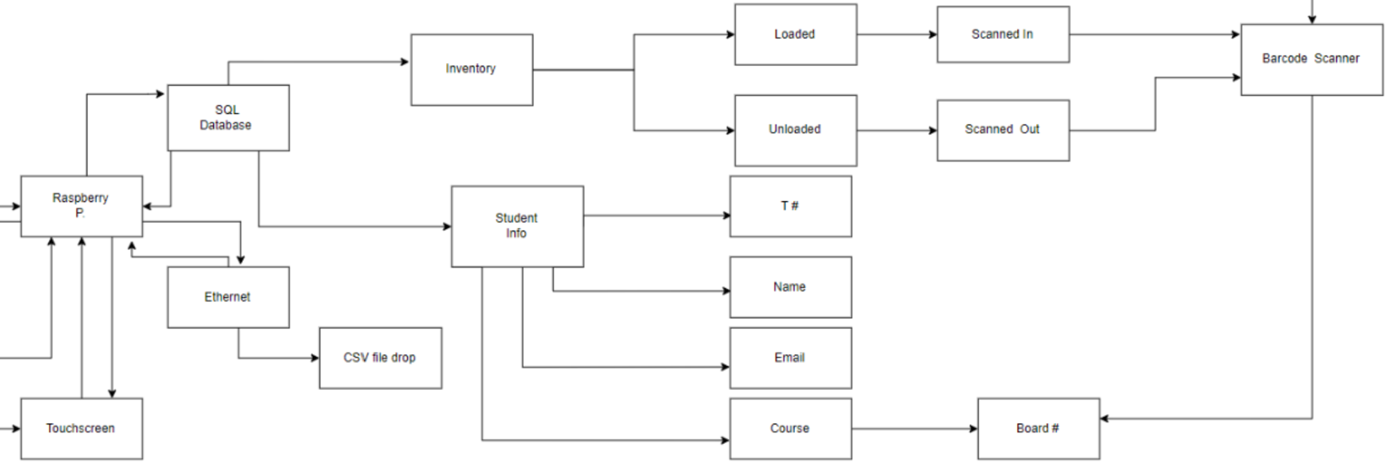
SQL Database
Inventory
Loaded
Unloaded
Student Information
T#
Name
Email
Course & Board#
Ethernet
CSV File

Slide 6
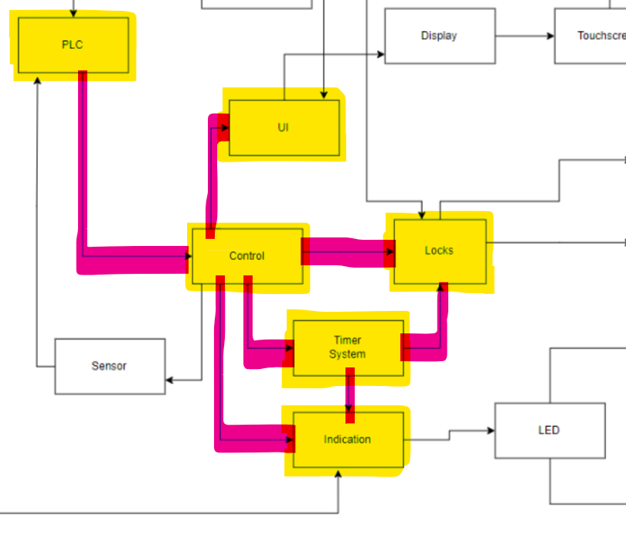
Hardware connections
PLC
HW Control
UI
Locks
Indication
Timer System
Sensors (Addressed later)

Slide 7
Plc / Control
PLC
Powered from wall outlet
Outputs to Control
Control
Hardware control
Outputs to Sensors, UI, Locks, Timer System, Indication System

Slide 8
Hardware subsystems
UI
Communicates with Pi and PLC to create display and store info in database
Locks
Most likely solenoid (Proposed by MechE team)
Powered by DC voltage
Indication System
Most likey LEDs. Will help guide student to correct drawer and compartment
Controlled by PLC
Timer System
Used to flash LEDs and unlock compartments over a predetermined duration
Controlled by PLC

Slide 9
Mick

Slide 10
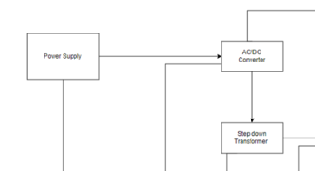
Power
Power Supply
AC/DC Converter
Step Down Transformer
Op-Amp Circuit

Slide 11
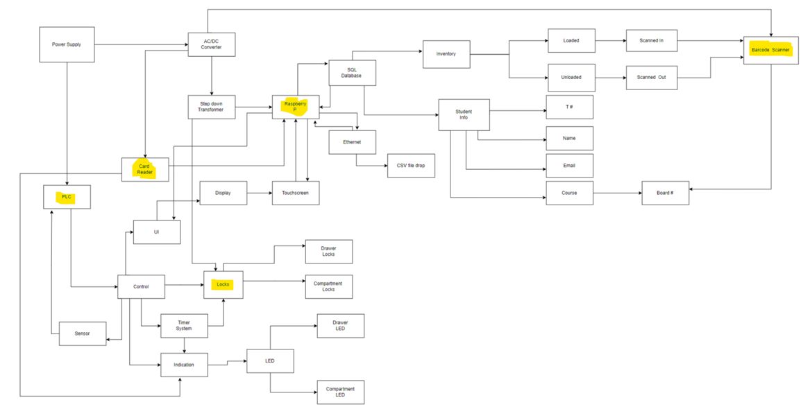
Systems that require Power
Raspberry Pi
Barcode Scanner
PLC
Locks
Card Reader

Slide 12
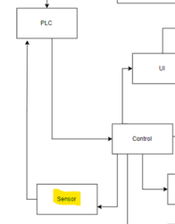
Sensors
To determine stock of each compartment
Considerations:
Photo Eye Light Sensor
Scale Weight Sensor

